Slide 1
IBM/Coursera Data Science Capstone Project Opening an Indian Restaurant in San Francisco
By Yash Kamat
September 2020

Slide 2
Business Problem
San Francisco is a multicultural city with a variety of cuisines. The growing South Asian population makes it a lucrative location open a new Indian Restaurant.
The primary audience of this study is meant to be entrepreneurs and restaurateurs in San Francisco.
Business Problem - if someone were to open an Indian restaurant in the city of San Francisco, where would should they open it?

Slide 3
data
Required Information:
List of neighborhoods in San Francisco.
Latitude and longitude of the neighborhoods of San Francisco.
Geolocation and venue data, specifically for Indian restaurants in San Francisco.
Sources of Data:
https://en.wikipedia.org/wiki/Category:Neighborhoods_in_San_Francisco
Python “geocoder” library
Foursquare API

Slide 4
Methodology
Python-based web scraping the Wikipedia page to get a list of neighborhoods.
Extract geographical coordinates using Python geocoder.
Retrieve location-specific venue data using the Foursquare API.
Group data by neighborhood and find the average frequency of Indian restaurants.
Use K-Means clustering to cluster data based on frequency of Indian restaurants.
Analyze data, infer trends and build recommendations to stakeholders.

Slide 5
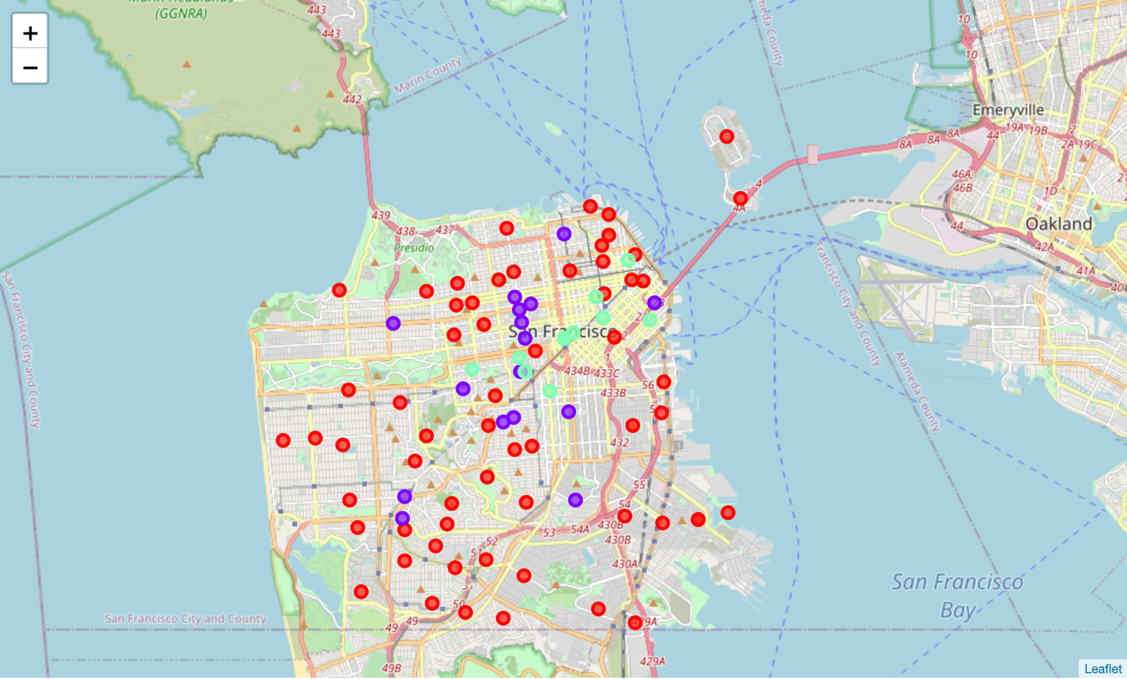
Results
Neighborhoods categorized into 3 main clusters:
Cluster 0: Neighborhoods with no Indian restaurants (frequency = 0). Shown in red.
Cluster 1: Neighborhoods with substantial number of Indian restaurants (frequency > 0.1). Shown in purple.
Cluster 2: Neighborhoods with moderate number of Indian restaurants (frequency = 0.1). Shown in mint.

Slide 6
Discussion & Recommendations
Majority of neighborhoods (cluster 0) have a low frequency of Indian restaurants. This provides opportunity but lacks any indication that there is demand for the cuisine in those areas.
Neighborhoods in Cluster 1 have a sizeable number of Indian restaurants, but the increased competition might make it more difficult to launch into the market.
Cluster 2 provides the best mixture of opportunity and demand for the service, as shown by its medium frequency of Indian restaurants.

Slide 7
Conclusion
Initial set out to answer the question - if someone were to open an Indian restaurant in the city of San Francisco, where would should they open it?
Based on the clustering analysis, the answer to the business problem would be the neighborhoods in the cluster 2.
This information will be helpful to entrepreneurs and restaurateurs looking to open an Indian restaurant in San Francisco.

Slide 8
Thank you!

